Slide 1
What can AIGC tools do in a Chemistry Lab
Ai He
2023-06-02

Slide 2
CONTENTS
What's ChatGPT?
Work with ChatGPT
Other GPT-based tools
AI image generators: Create science image
Acknowledgment

Slide 3
01
What's ChatGPT?

Slide 4
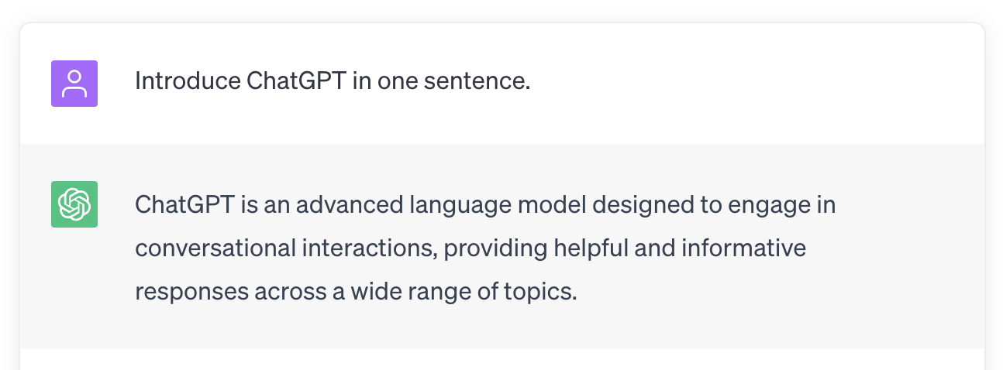
What's ChatGPT?

Slide 5
02
Work with ChatGPT

Slide 6
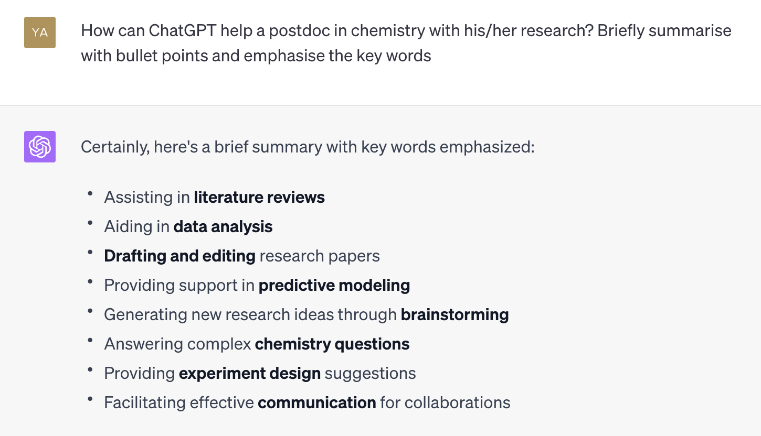
Work with ChatGPT

Slide 7
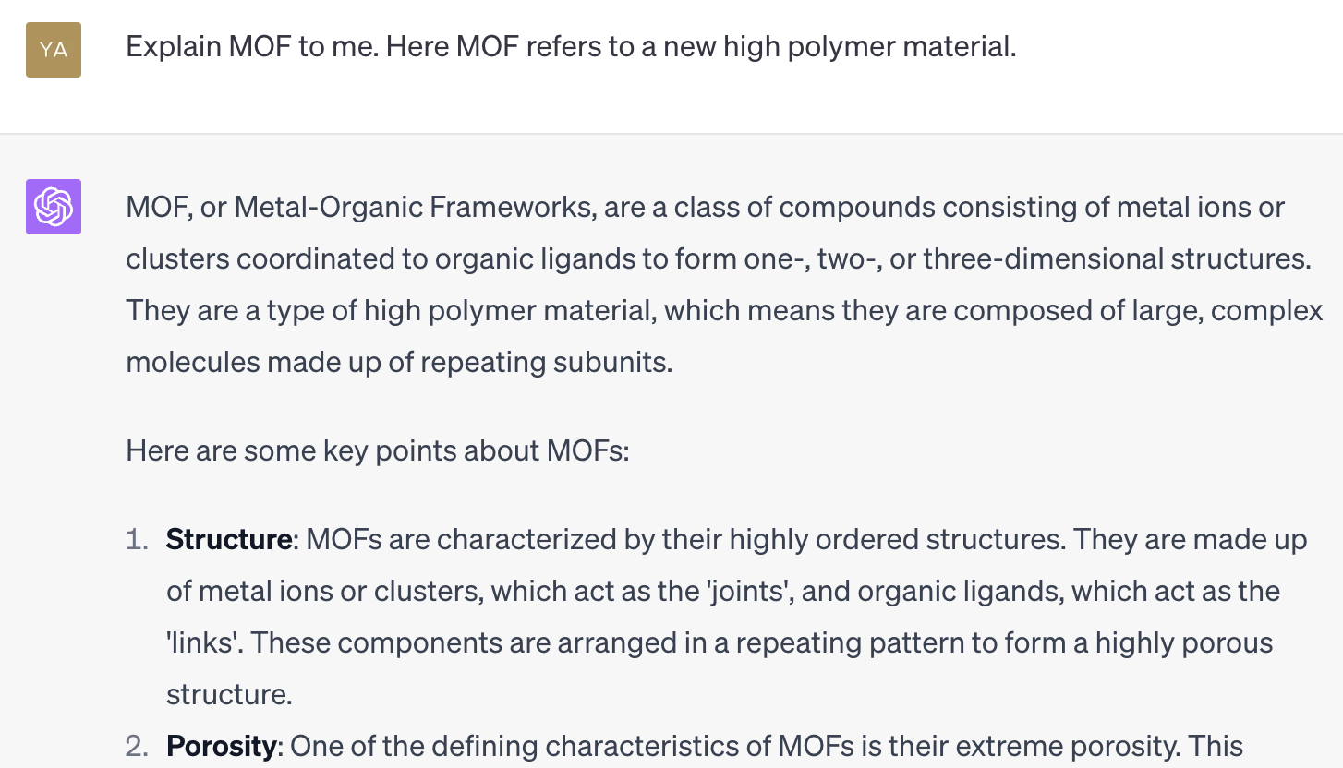
Answer questions

Slide 8
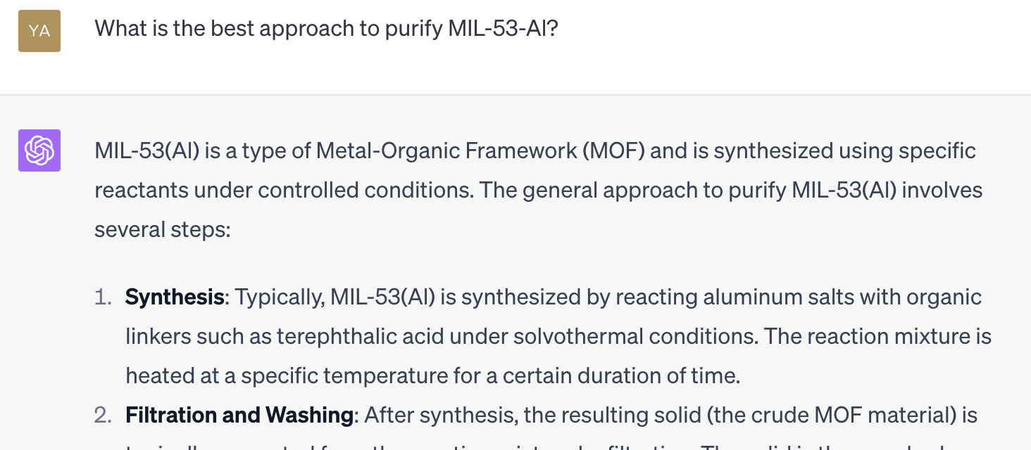
Help design experiments

Slide 9
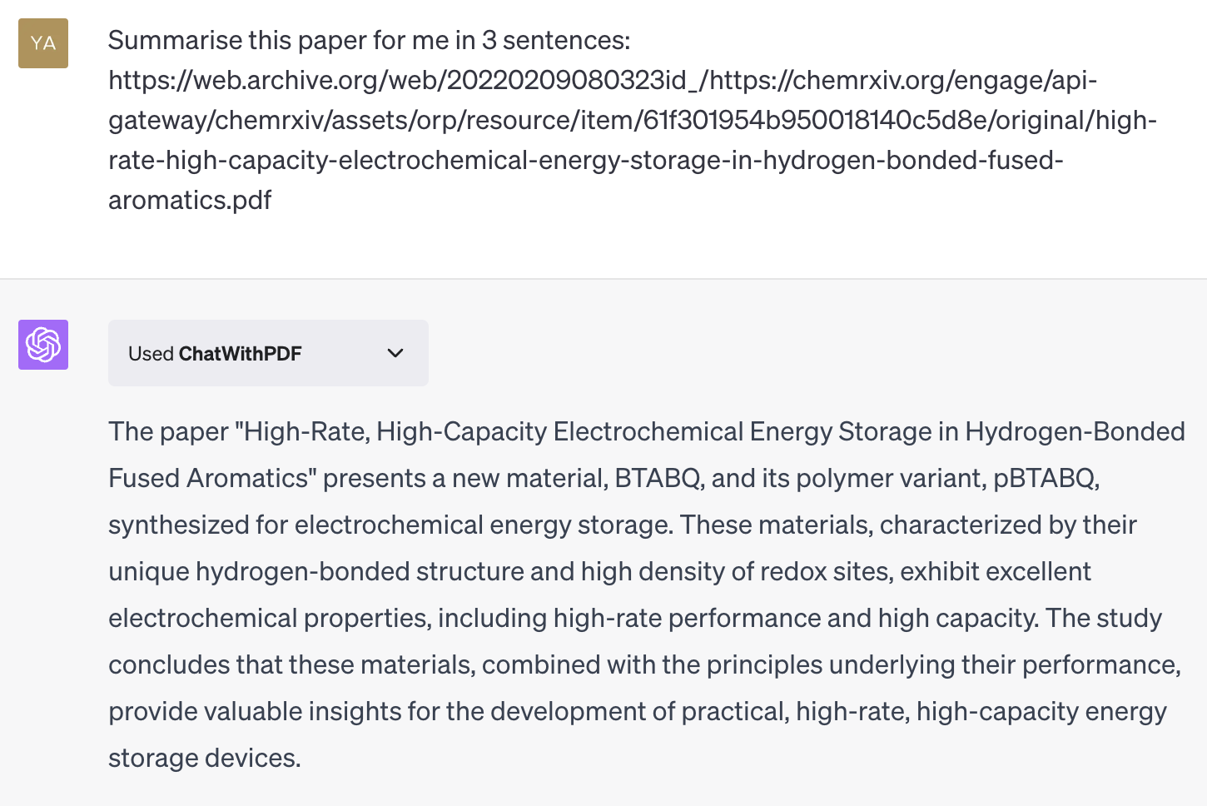
Literature review

Slide 10
03
Other GPT-based tools

Slide 11
Other GPT-based tools
New Bing: Help searching and summarising the internet
Github Copilot: Coding assistant
Notion AI: Help to create notes

Slide 12
04
AI image generators: Create science images

Slide 13
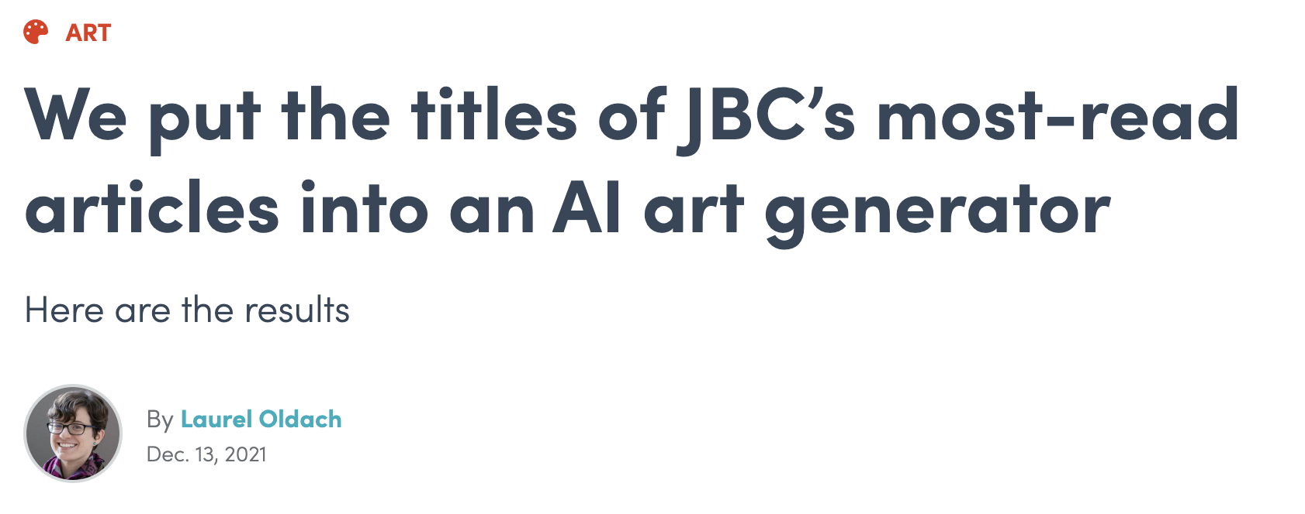
AI image generators: Create science images
https://www.asbmb.org/asbmb-today/science/121321/ai-image-generator

Slide 14
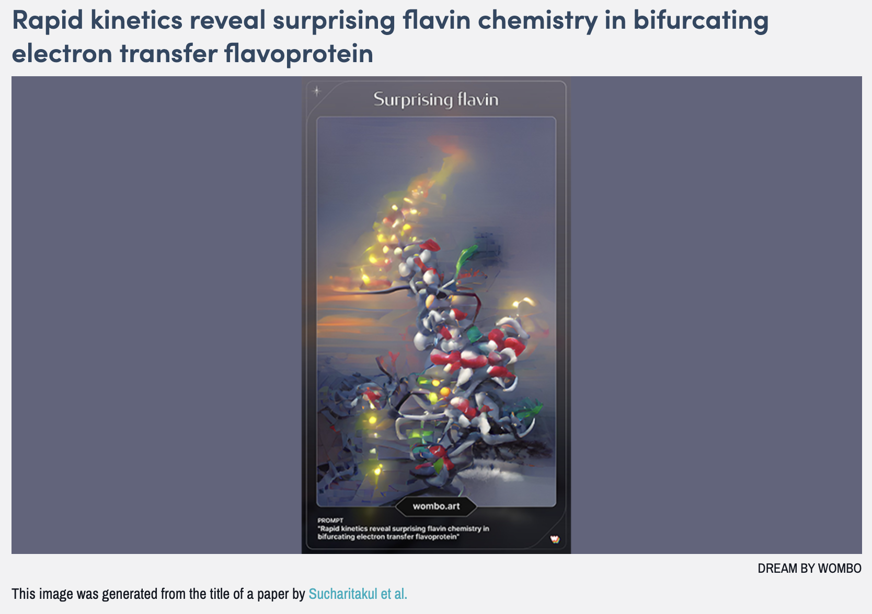
A result

Slide 15
05
Acknowledgment

Slide 16
Acknowledgment
Most content of this presentation is generated by ChatGPT.
The slides are designed by MindShow (https://www.mindshow.fun/)

Slide 17
THE END
THANKS

